Slide 1

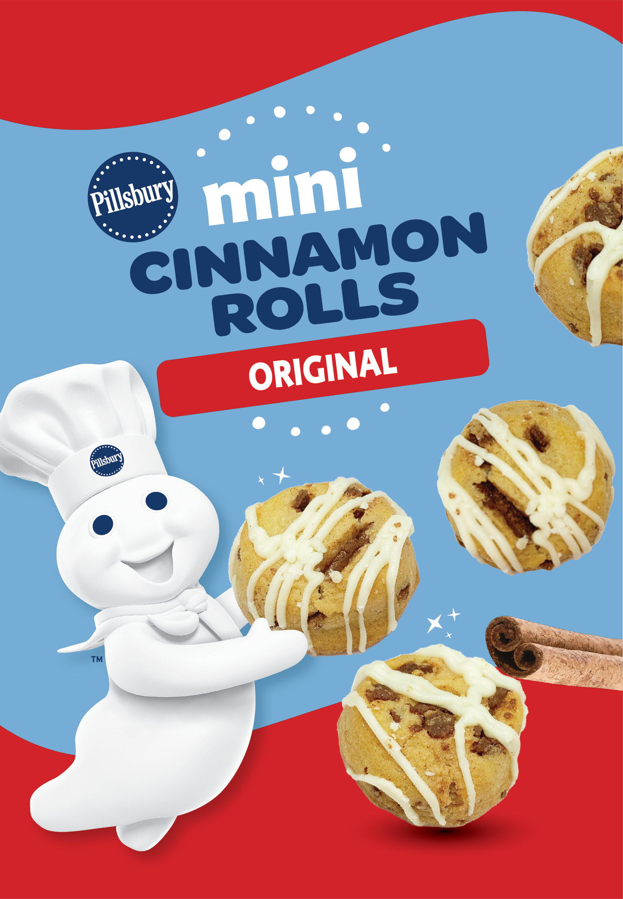
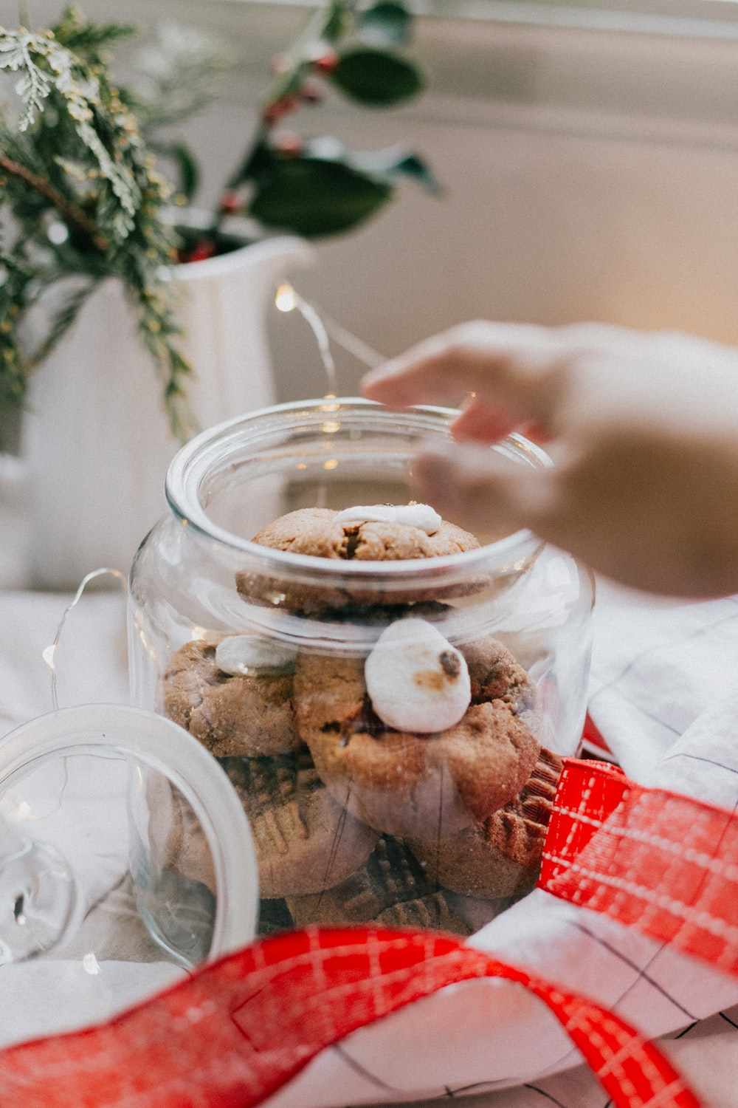
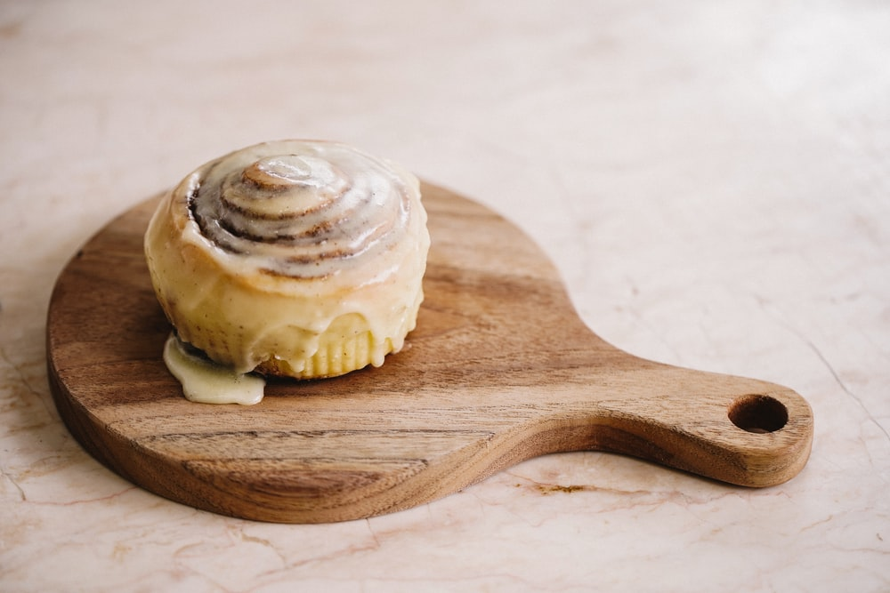
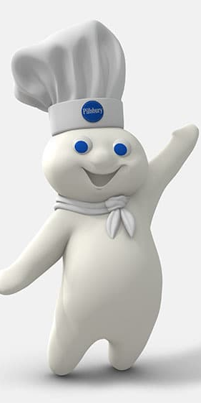
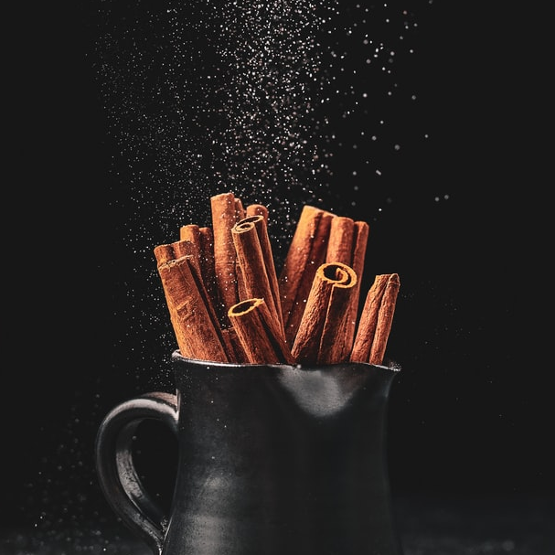
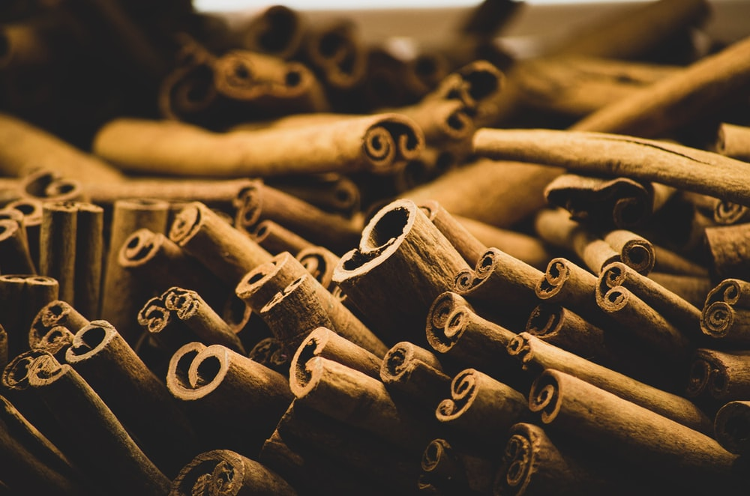
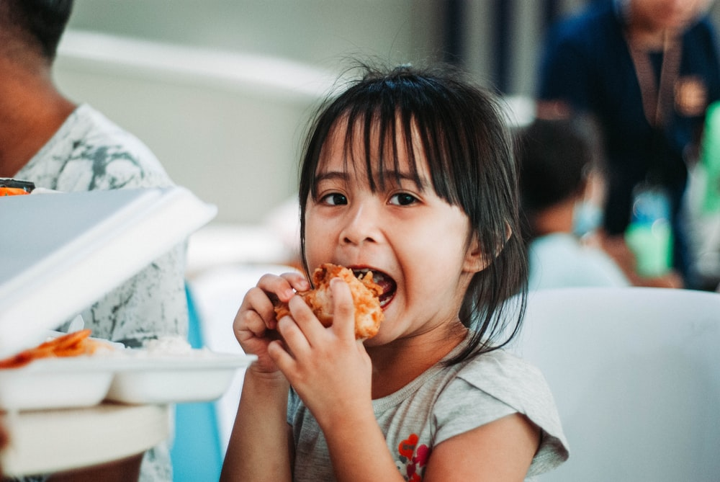
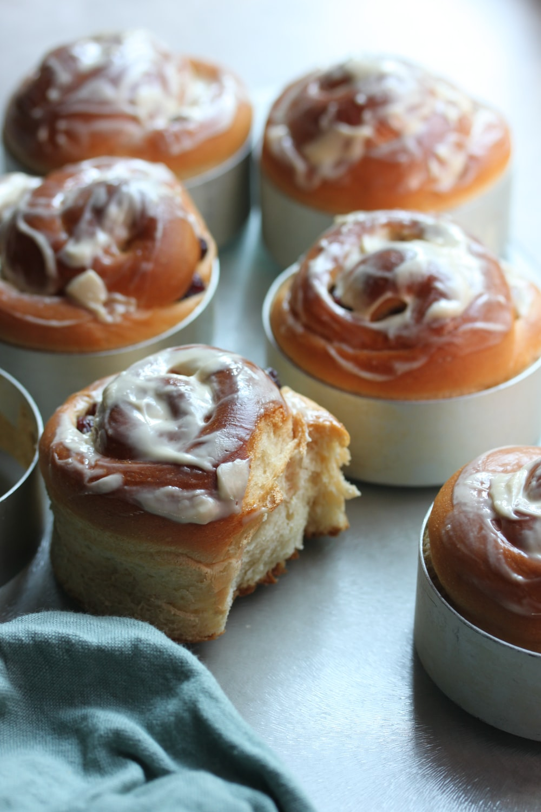
Mini Cinnamon Roll Validation
318066
Prepared for Janavi Kumar and Courtney Schlossareck
23rd August 2022

Slide 2

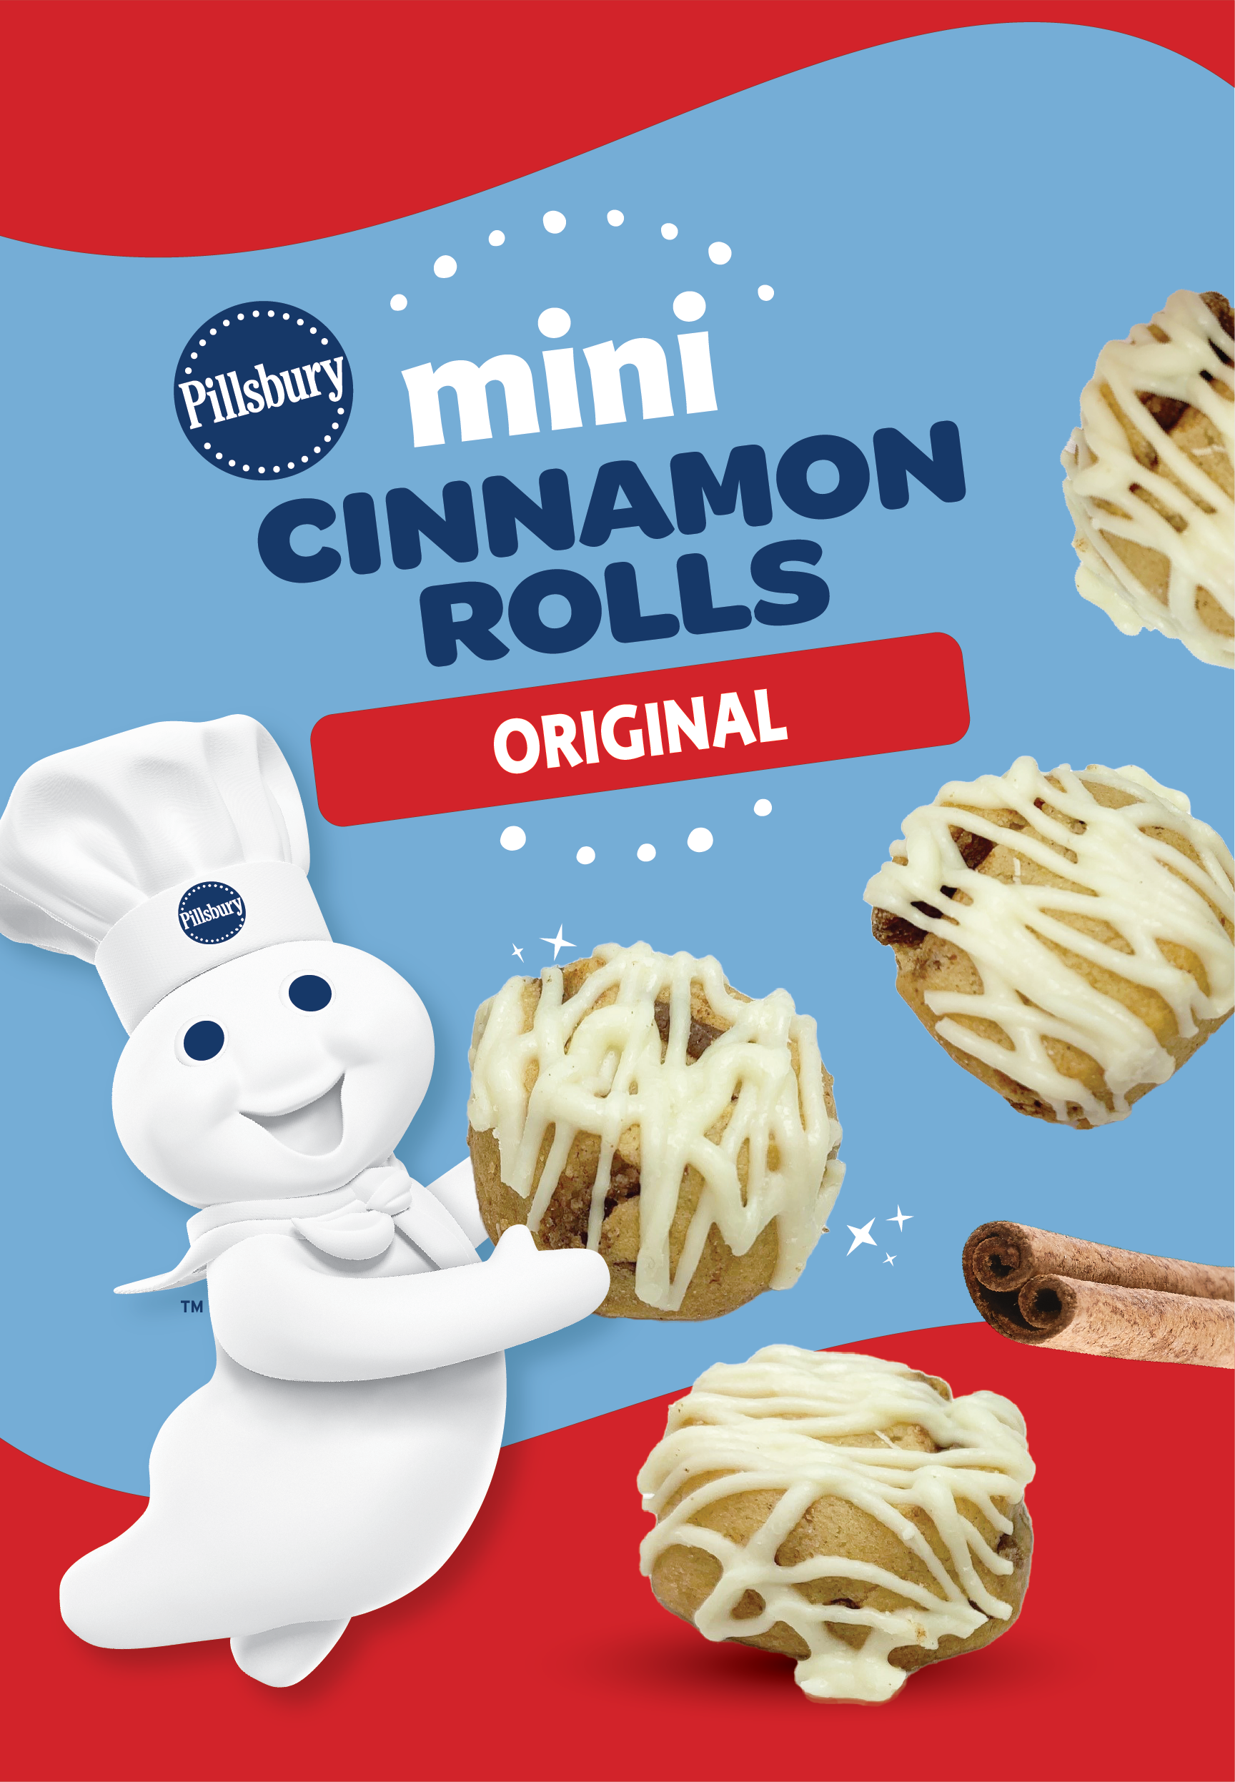
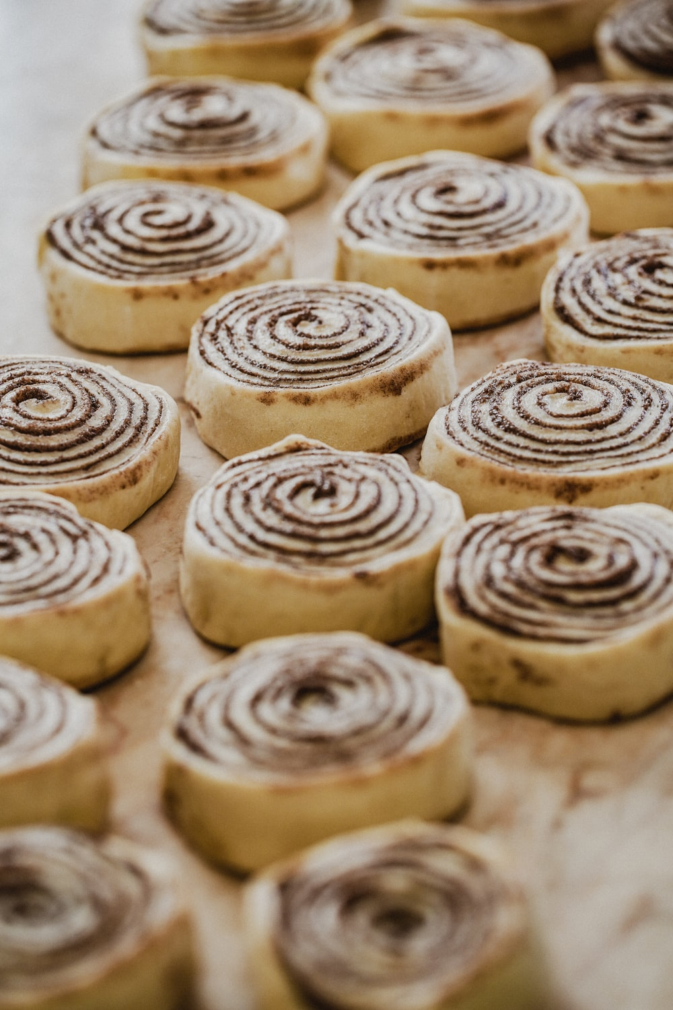
BACKGROUND
General Mill’s Pillsbury Cinnamon Roll’s are a fan-favourite for home baking. Looking to expand the brand repertoire and provide consumers with a convenient (no-bake) take, they designed a new ‘Mini’ Cinnamon Roll concept and 2 associated prototypes.
However, despite their branding, the practicality of the rolls’ ‘Mini’ format has meant that General Mills is unable to create the classic Cinnamon Swirl as evident in traditional products. This research looks to understand fit to concept, and identify whether this no-swirl format is acceptable for progression to market.
Low Drizzle Concept
High Drizzle Concept
Methodology
Consumers evaluate 2 samples at a CLT, answering standard ballot questions before and after consuming the prototypes.
Assessment of open ended verbatims around each sample in turn, including “What do you like about the sample?” and “What, if anything, would you change about this sample to make it better?”
MMR has implemented their text analytic tools to analyse this data in detail

Slide 3
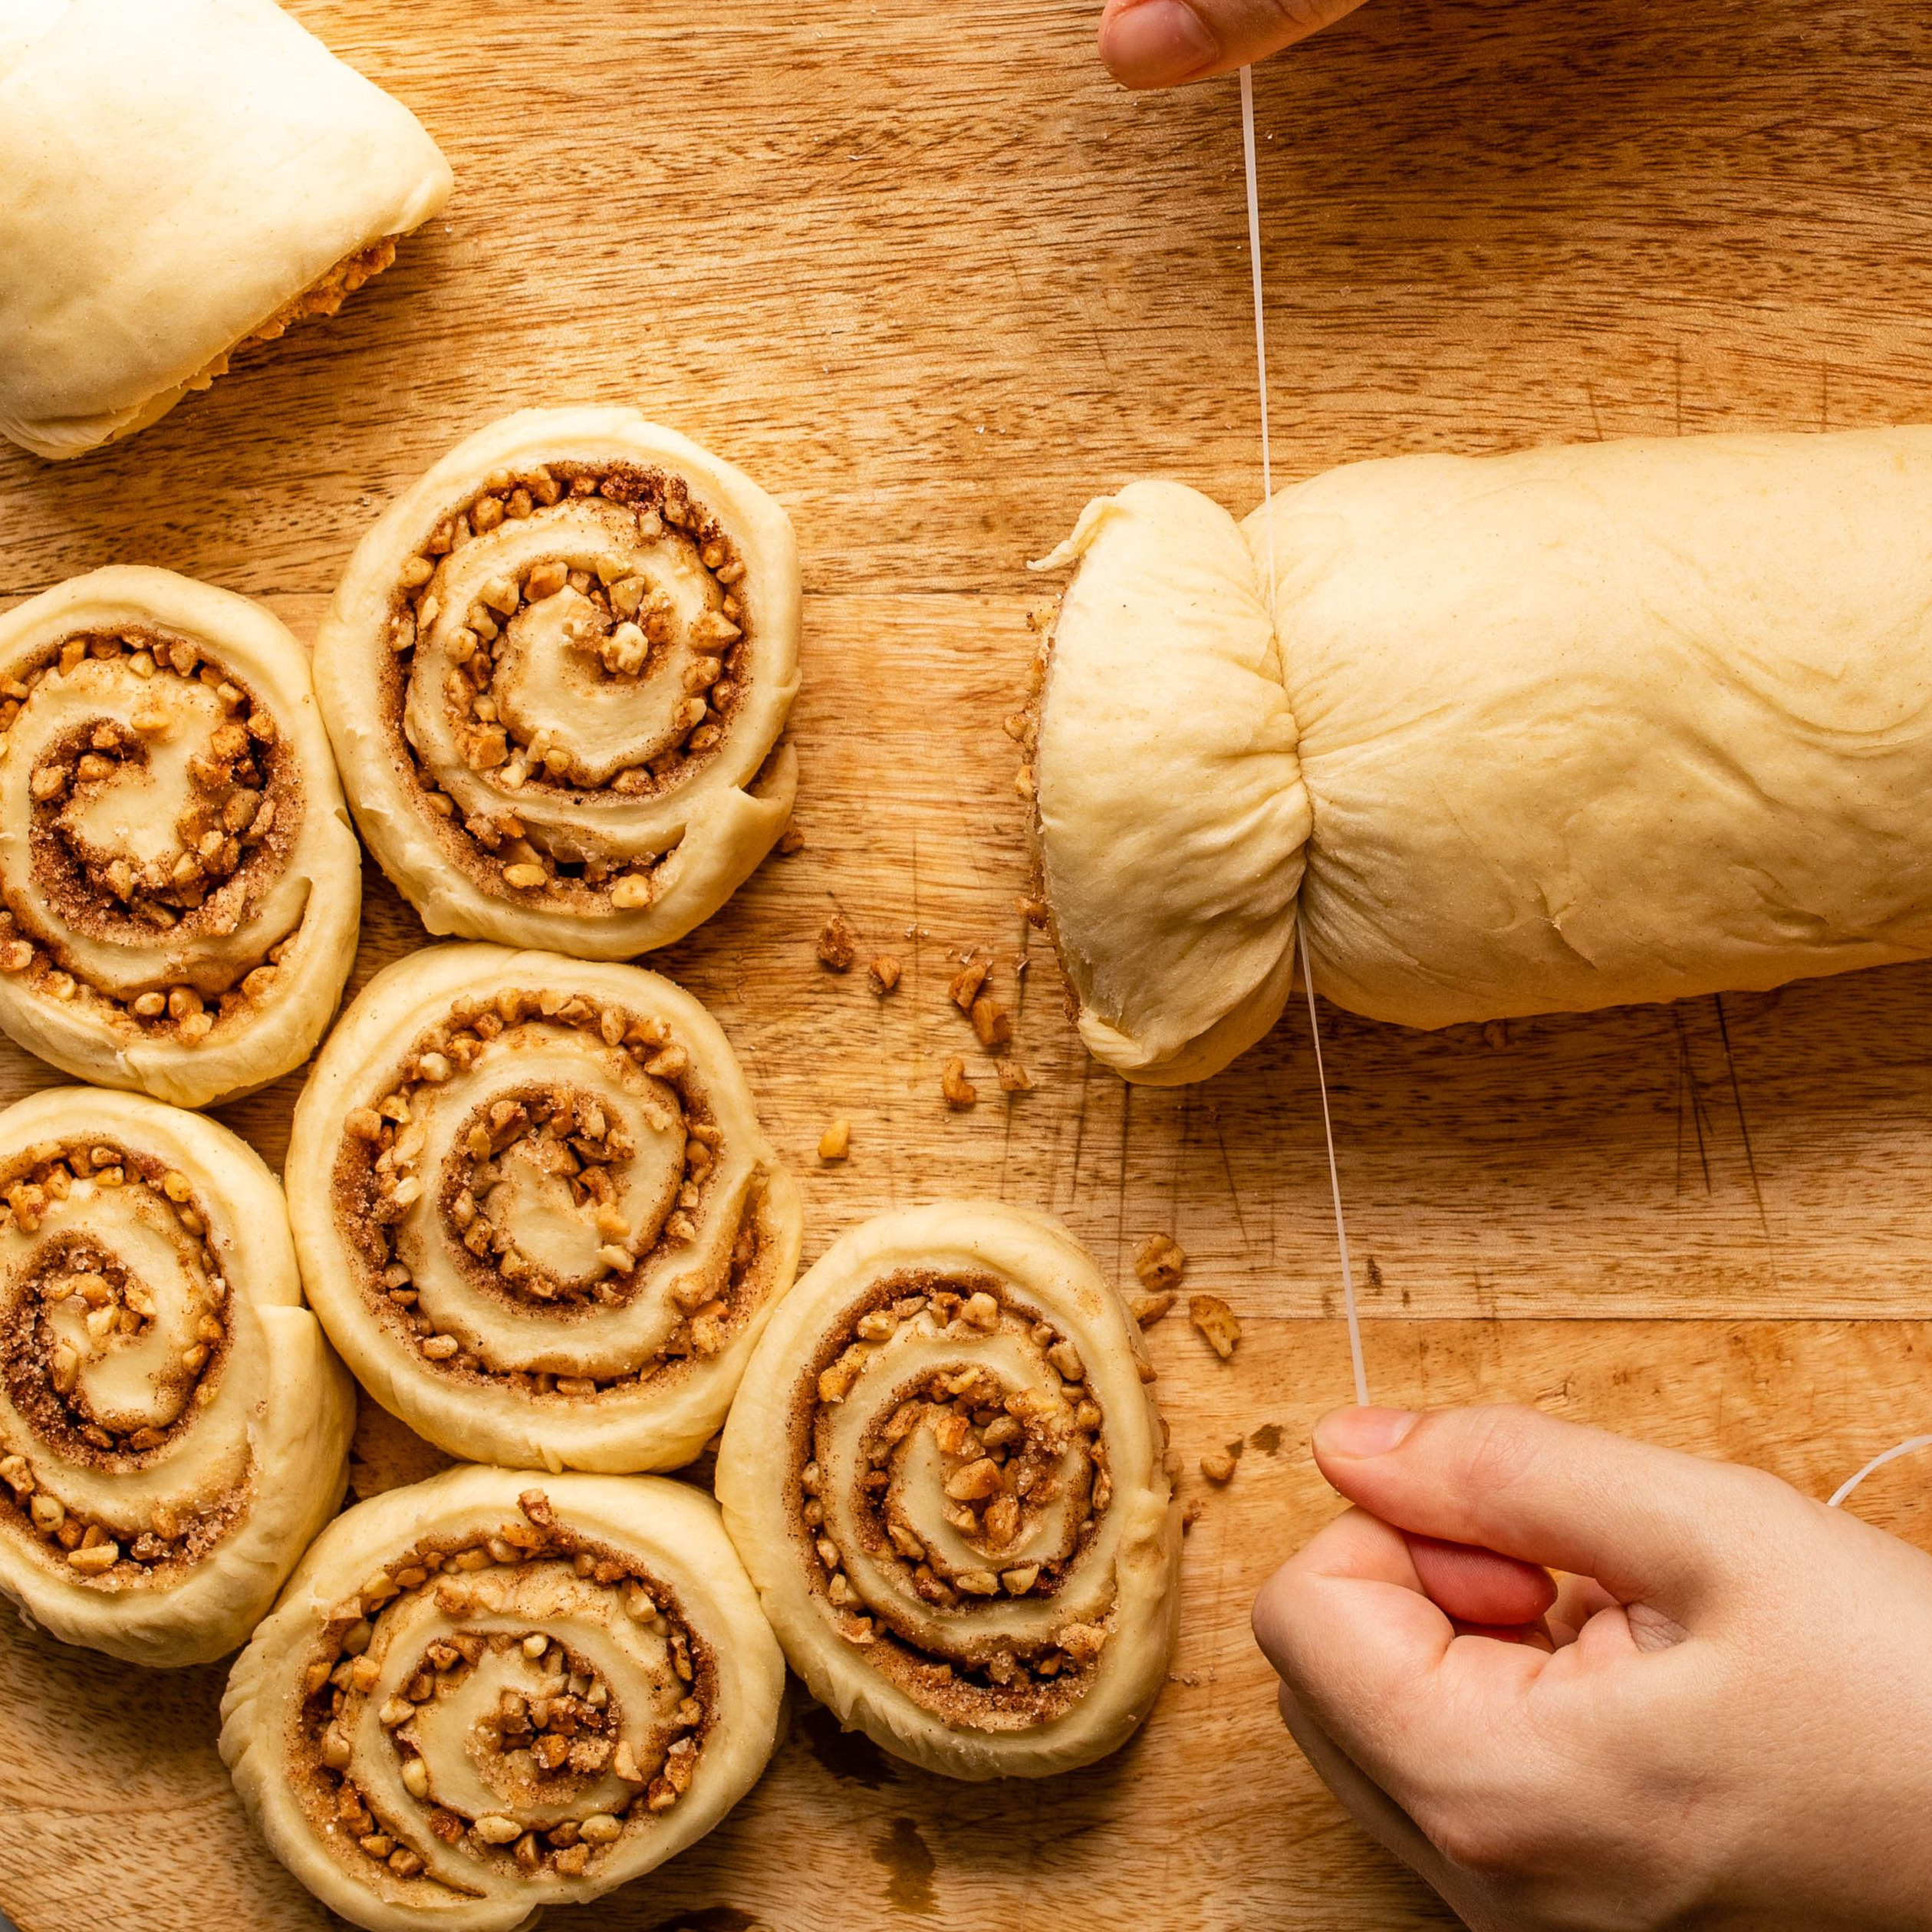
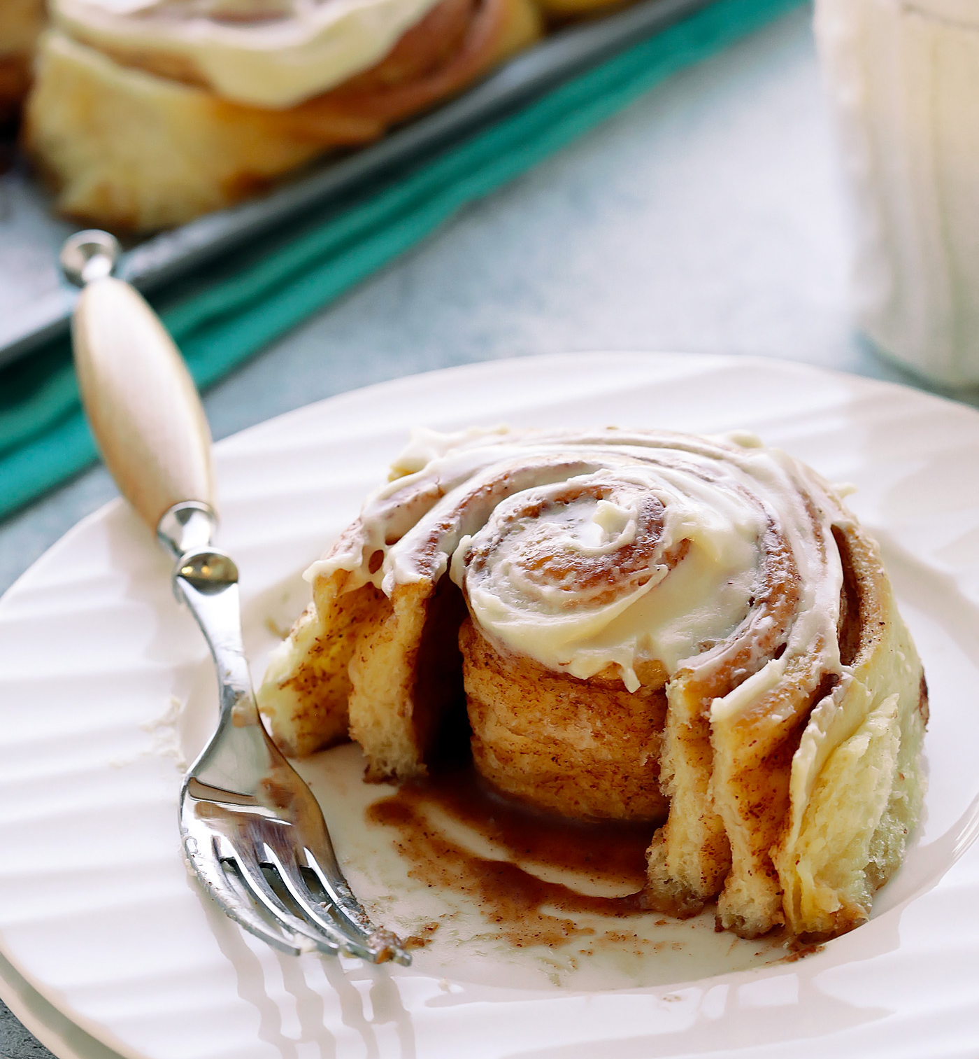
EXECUTIVE SUMMARY
1
Both products are ok overall, but ultimately too ‘cookie-like’, dense, & small. Their flavor profiles also have room for improvement, with a need to balance between the frosting, cinnamon & sweetness. Overall, High Drizzle’s amount of frosting would be best option for progression.
2
Alongside the previous ‘Meet Expectations’ data, it is clear that General Mills have two potential routes; optimise the product profiles and/or optimise the product marketing. MMR recommends both routes in tandem to improve product delivery and their fit to expectations

Slide 4
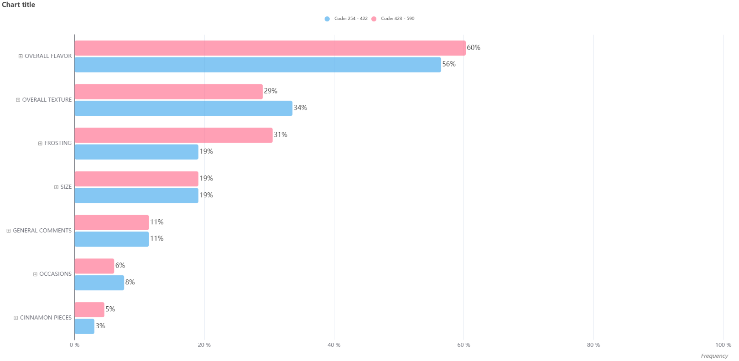
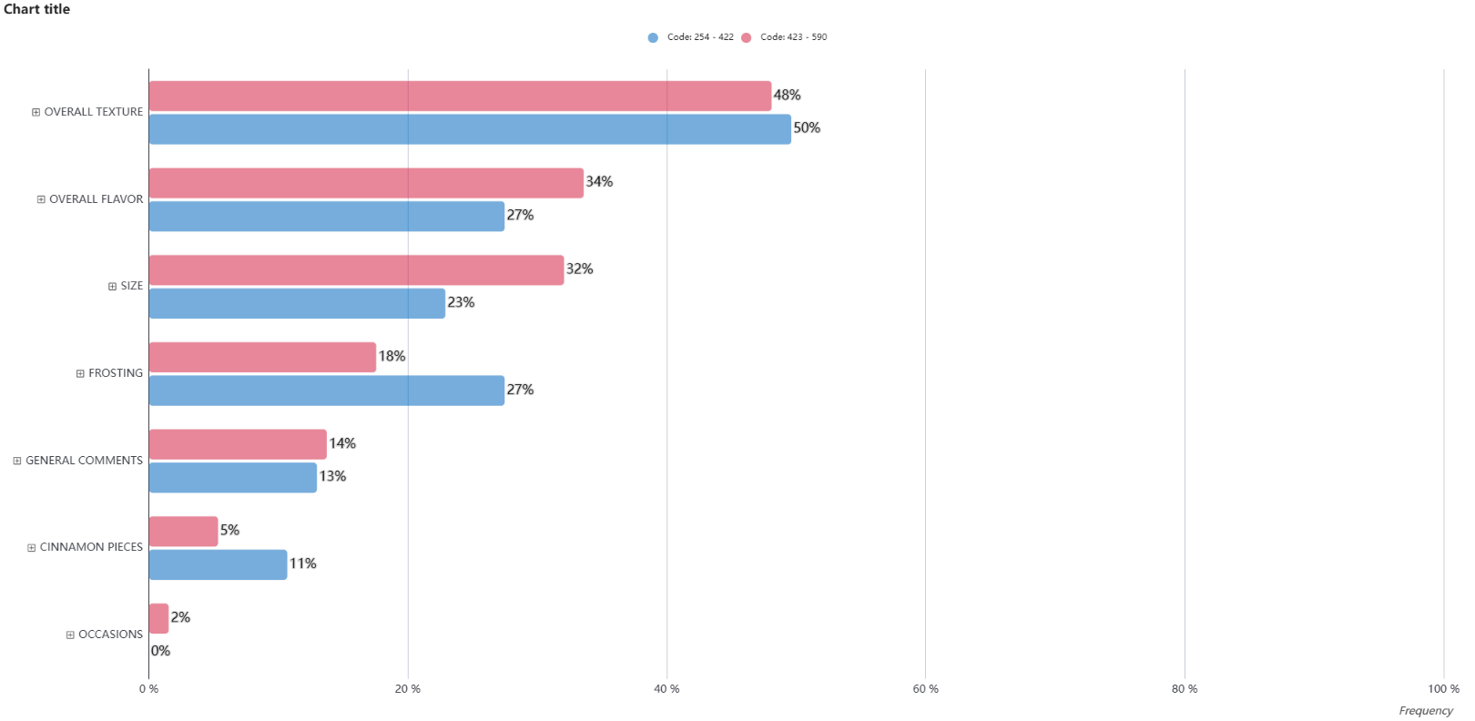

A RESPECTABLE STARTING LINE
Both products perform ok overall, with clear routes for optimisation with regards to
Texture, Flavor, Frosting & Size
Like
Change
Topics
Topics
Frequency
Frequency
590 (High Drizzle)
254 (Low Drizzle)
KEY
What do you like about the sample?” / “What, if anything, would you change about this sample to make it better?” N=c.131

Slide 5

COMMONALITY ACROSS THE DATA
For those whom the products didn’t meet expectations, consumers mentioned that they also didn’t like their “cookie-like” format
These occurrences are a small number (15 in total) but are equal in mentions across the product set
This highlights a clear need for optimization of the product texture…
“Like a cookie”: Negative
15 occurrences
Didn’t meet expectations
“What, if anything, would you change about this sample to make it better?” N=c.131

Slide 6
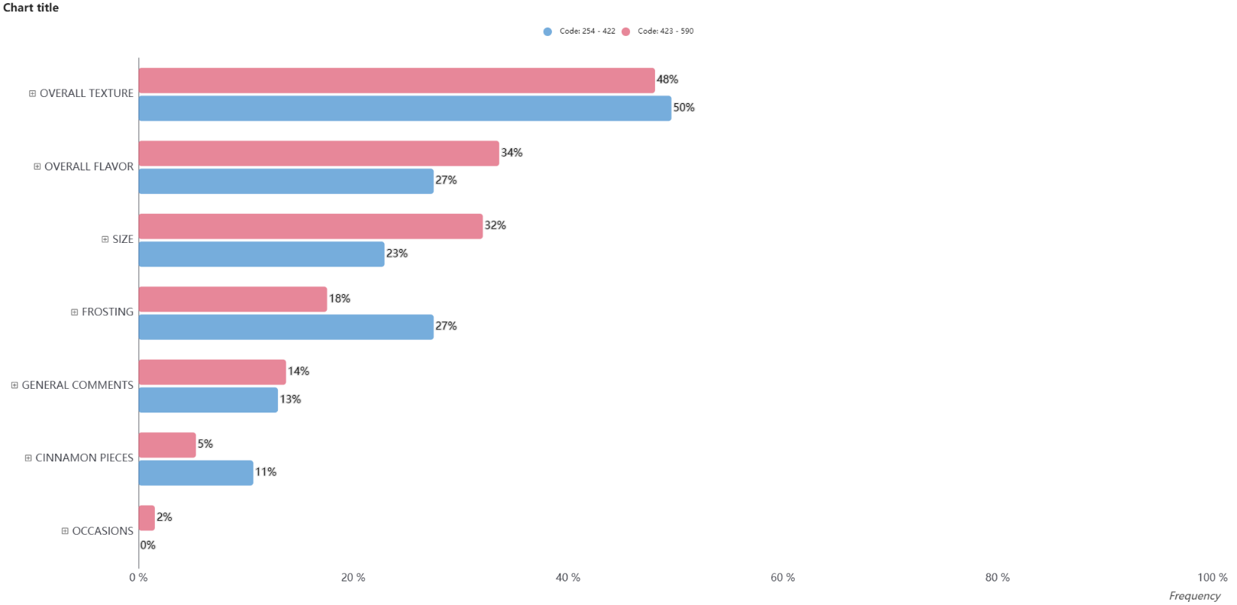
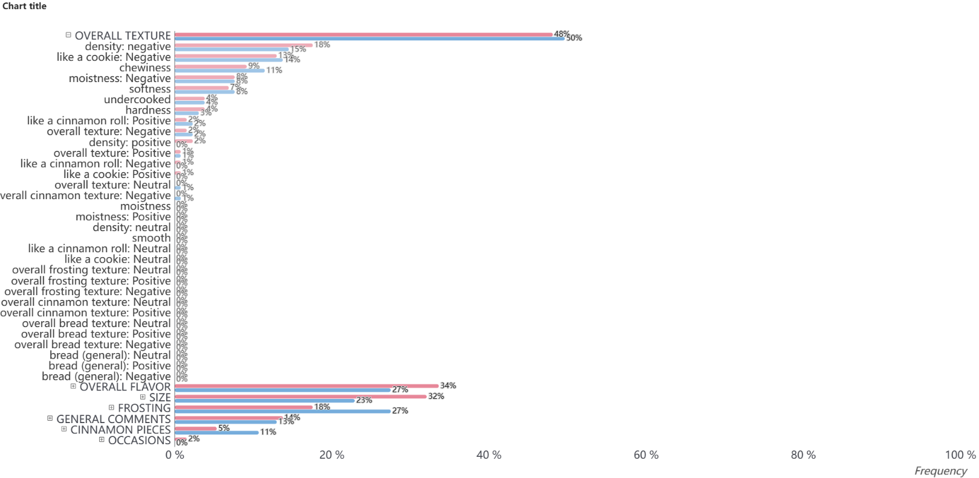
A DIVE INTO THE COOKIE-LIKE TEXTURE
Almost half of all consumers would have preferred to change the texture of either the High or Low Drizzle products, with both being described as being far too dense, chewy and for some “doughy”
Their textures are ultimately far too dissimilar from a traditional cinnamon roll for which consumers expect something “fluffy”, “light” and “soft”
Change
Topics
“It needs to be fluffier and a little bigger.”
“Texture is like a cookie instead of a roll. It feels like it didn’t rise and has that doughy feel when I bite it”
“More of a roll /bread texture that is less dense. Less cinnamon for such a small amount.”
“The texture is more like a soft cookie rather than a cinnamon roll. It does not have the firmness of a cinnamon roll.”
590 (High Drizzle)
254 (Low Drizzle)
KEY
“What, if anything, would you change about this sample to make it better?” N=c.131

Slide 7
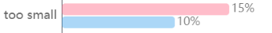

A DIVE INTO THE COOKIE-LIKE TEXTURE
Almost half of all consumers would have preferred to change the texture of either the High or Low Drizzle products, with both being described as being far too dense, chewy and for some “doughy”
Their texture’s are ultimately far too dissimilar from a traditional cinnamon roll for which consumers expect something “fluffy”, “light” and “soft”
Change
Topics
The density of these products are compounded by their smaller size, for which High Drizzle appears to be at a greater disadvantage.
Overall, it is clear that the products fail to meet expectations of a cinnamon roll, and careful consideration should be taken in marketing the product to ensure alignment
“It needs to be fluffier and a little bigger.”
“Texture is like a cookie instead of a roll. It feels like it didn’t rise and has that doughy feel when I bite it”
POINT OF VIEW
“More of a roll /bread texture that is less dense. Less cinnamon for such a small amount.”
“The texture is more like a soft cookie rather than a cinnamon roll. It does not have the firmness of a cinnamon roll.”
590 (High Drizzle)
254 (Low Drizzle)
KEY
“What, if anything, would you change about this sample to make it better?” N=c.131

Slide 8
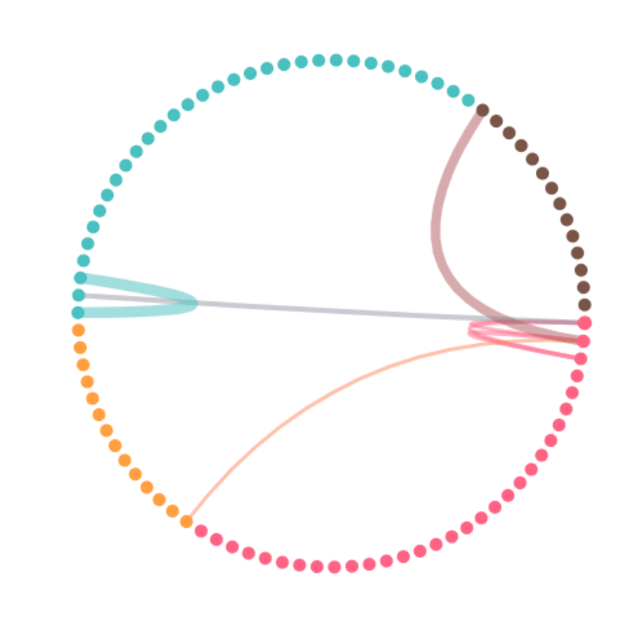

FLAVOR WAS THE STRONG SUIT OVERALL
Although the two products differed in regards to the balance of flavors (which differed dependent on the amount of cinnamon pieces, the frosting, and the overall sweetness), both perform relatively well…
Right amount of Cinnamon Pieces
Met Expectations
590 (High Drizzle)
Overall Texture: Positive
254 (Low Drizzle)
Softness
Chewiness
Overall Texture: Positive
Softness
Overall Flavour: Positive
Overall Flavour: Positive
Overall Cinnamon Flavour: Positive
Overall Sweetness: Positive
Overall Sweetness: Positive
Balanced
Right amount of Frosting
Right amount of Frosting
Good cinnamon flavour, could have more
Less dense, but still not fluffy enough
Less frosting, could be sweeter
Stronger cinnamon flavour
Denser, more chewy
Preferred amount of frosting for most
What do you like about the sample?” N=c.131

Slide 9
HIGH DRIZZLE HAD A STRONGER CINNAMON FLAVOR
590 (High Drizzle)
For most consumers, High Drizzle’s cinnamon flavor was good, and it balanced well with the sweetness of the frosting. For some, though, the flavor was too strong and consequently tasted a little artificial.
Questions Combined
Overall Flavor
“This sample tasted like a cinnamon roll should taste. It left a very pleasant taste in my mouth. It was soft and chewable, and the frosting was very good”
“It tastes like fake or imitation cinnamon. Leaves weird aftertaste kinda like the fake aspartame does”
“The taste is very artificial, it is way too dense, very chewy and fake tasting”
“I really like the cinnamon flavor and overall taste. I especially like the texture and our kids would love these as a special breakfast treat”
“Great flavor notes of cinnamon with the right amount of sweetness”
Overall Liking 1-5
Overall Liking 6-9
KEY
What do you like about the sample?” / “What, if anything, would you change about this sample to make it better?” N=c.131

Slide 10
LOW DRIZZLE’s flavor profile could be stronger
254 (Low Drizzle)
There is more inconsistency in opinion for Low Drizzle in regards to flavor, which could be due to an imbalance caused by the lower amount of frosting. For some the product could benefit from being sweeter, and for others they’d prefer a stronger cinnamon flavor overall
Questions Combined
Overall Flavor
“The overall flavor was pretty close to an baked cinnamon roll so I enjoyed the flavor too”
“Needs to be sweeter, more icing, more like a cinnamon roll if advertised as one. This left a weird tacky flavor in my mouth”
“I liked the cinnamon flavor, it was sweet but not over powering.”
“Very dry and not flavorful enough. When making desserts you want to make them flavorful and not just sweet”
“Needs to be a bit sweeter. Little more frosting.”
“Add a little more cinnamon and make it a tad less sweet.”
Overall Liking 1-5
Overall Liking 6-9
KEY
What do you like about the sample?” / “What, if anything, would you change about this sample to make it better?” N=c.131

Slide 11
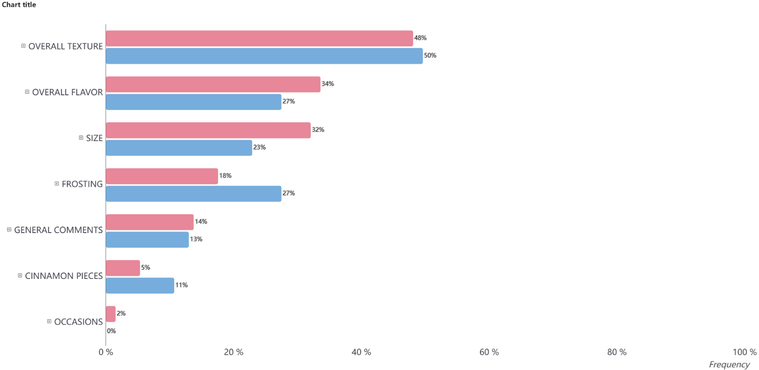
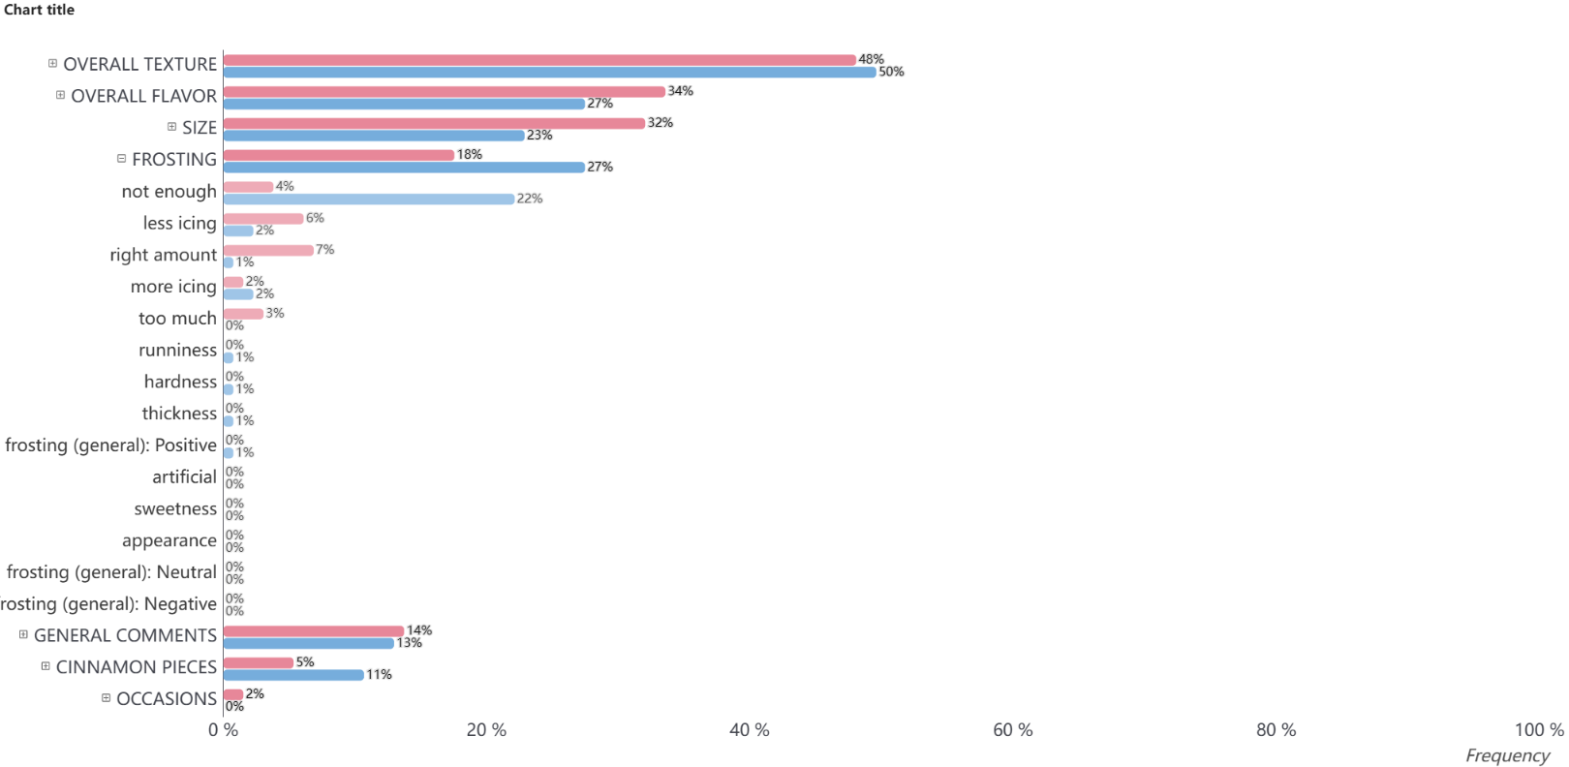
HIGH FROSTING IS CHAMPIONED
On the whole, consumers prefer High Drizzle’s amount of frosting, with many commenting that it helps balance the flavor and add moistness
That being said, High Drizzle could still be improved with regards to flavor profile, as for some the roll itself could be stronger in cinnamon flavor to offset the frosting’s sweetness
Change
Topics
“The sweetness in the actual roll is a little too much with the right amount of frosting. More cinnamon in the roll and use the sweetness from the icing.”
“A tad more cinnamon but keep same amount of frosting to create a more balanced flavor.”
“I would make it at least double the size. I would also add a lot more moisture and some more frosting”
“It needs way more flavor and more frosting”
590 (High Drizzle)
254 (Low Drizzle)
KEY
What do you like about the sample?” / “What, if anything, would you change about this sample to make it better?” N=c.131

Slide 12

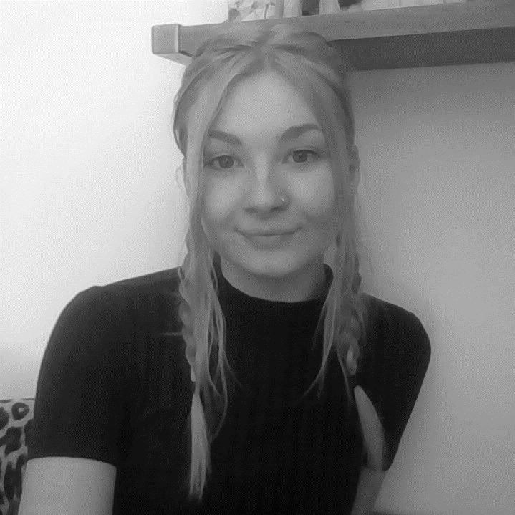
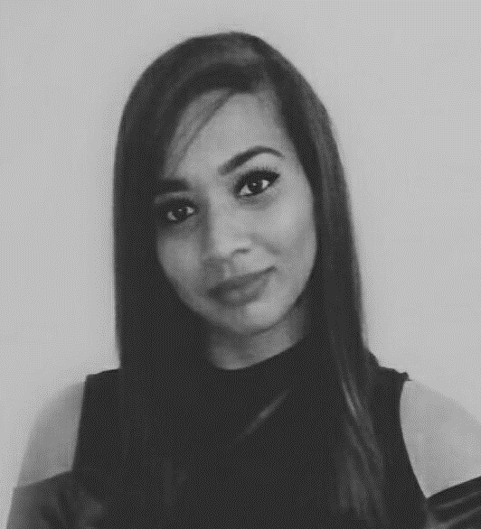
THANK YOU!
For anything further, please contact:
JACK COX
j.cox@mmr-research.com
ANNIE NELLER
ANNIE@NOVA-MMR.COM
KIM GOVENDER
K.GOVENDER@MMR-RESEARCH.COM

Slide 13
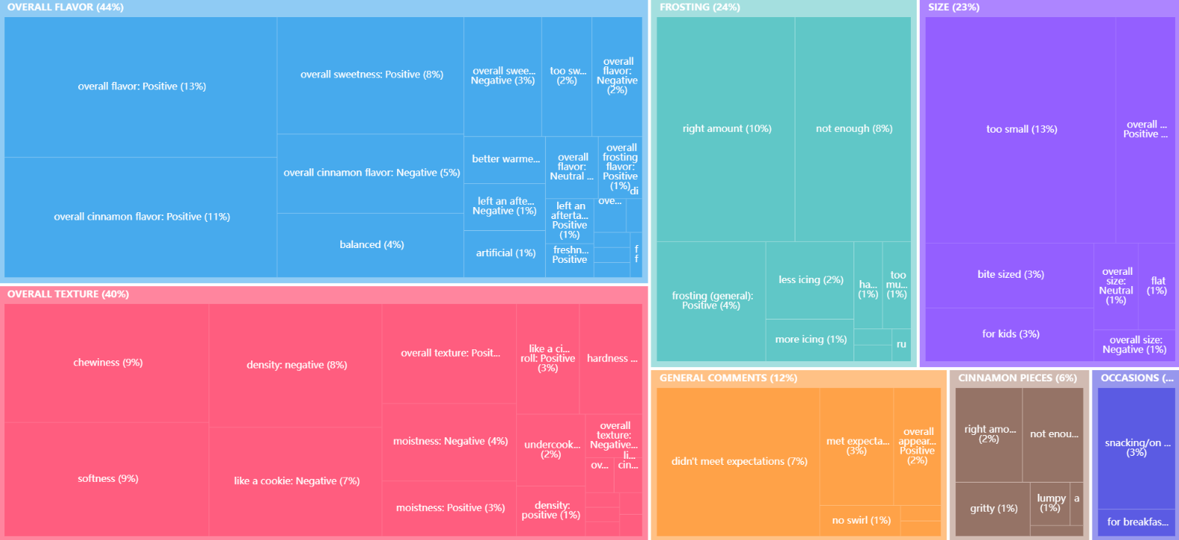
Both products and questions combined: overview
What do you like about the sample?” / “What, if anything, would you change about this sample to make it better?” N=c.131

Slide 14
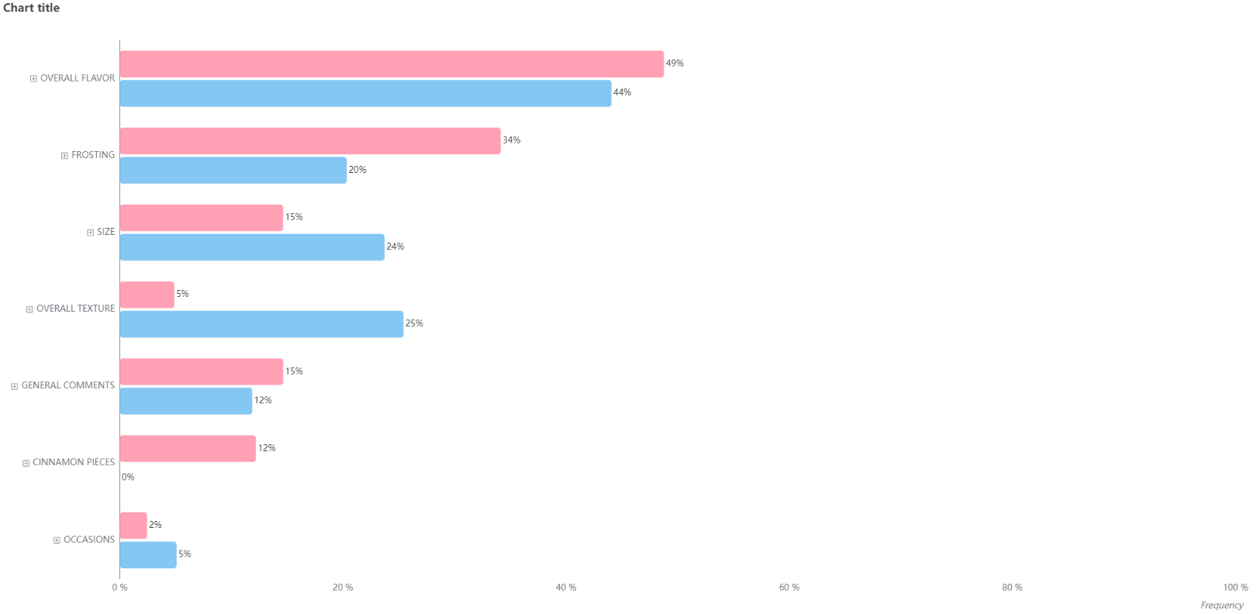
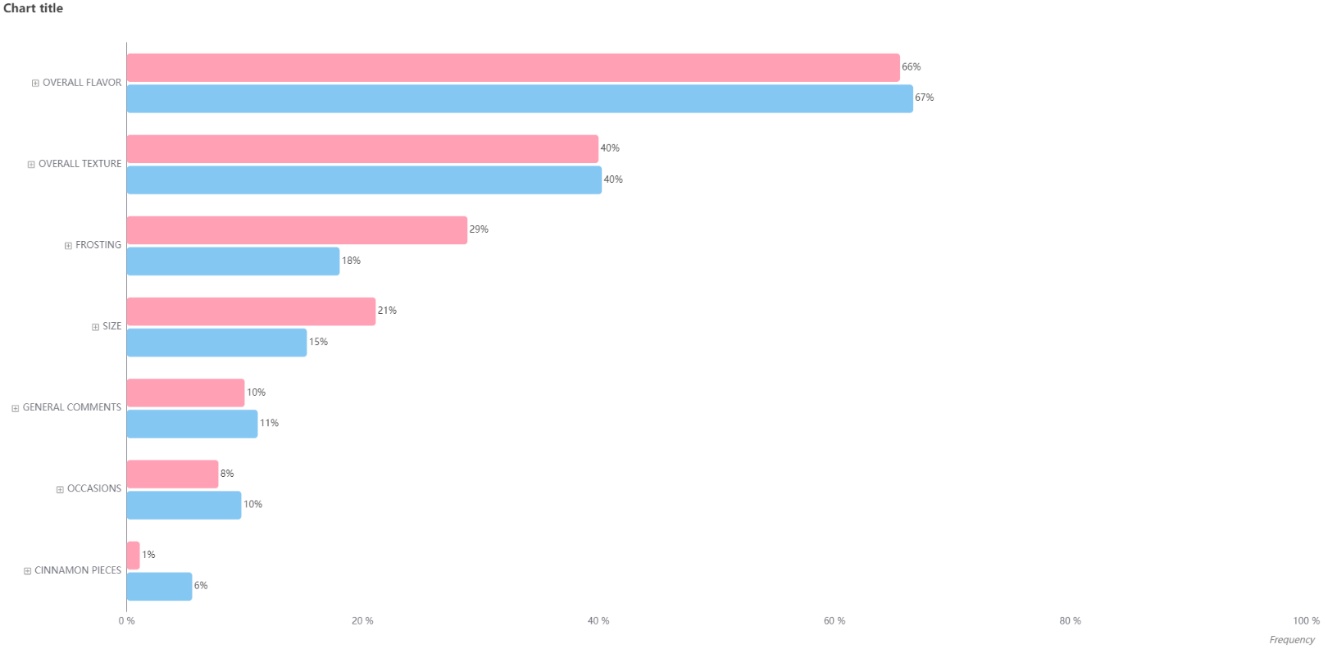
like
OO 1-5
OO 6-9
590 (High Drizzle)
254 (Low Drizzle)
KEY
What do you like about the sample?” / “What, if anything, would you change about this sample to make it better?” N=c.131

Slide 15
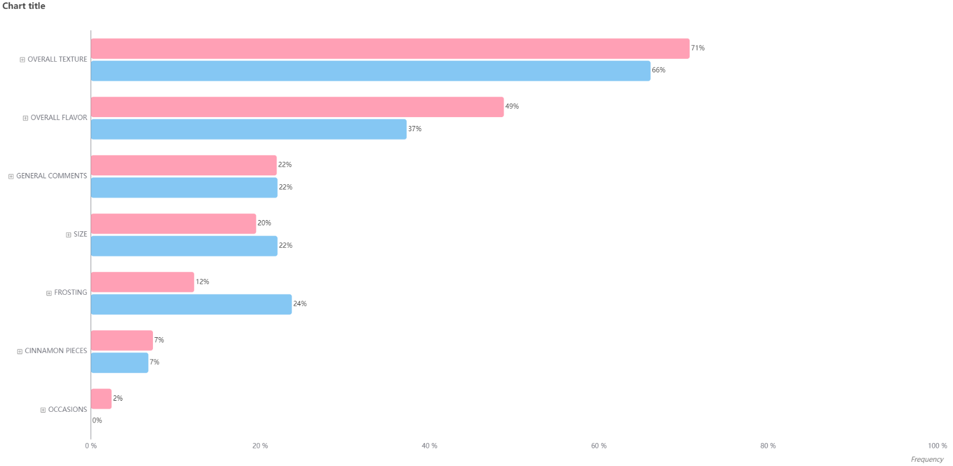
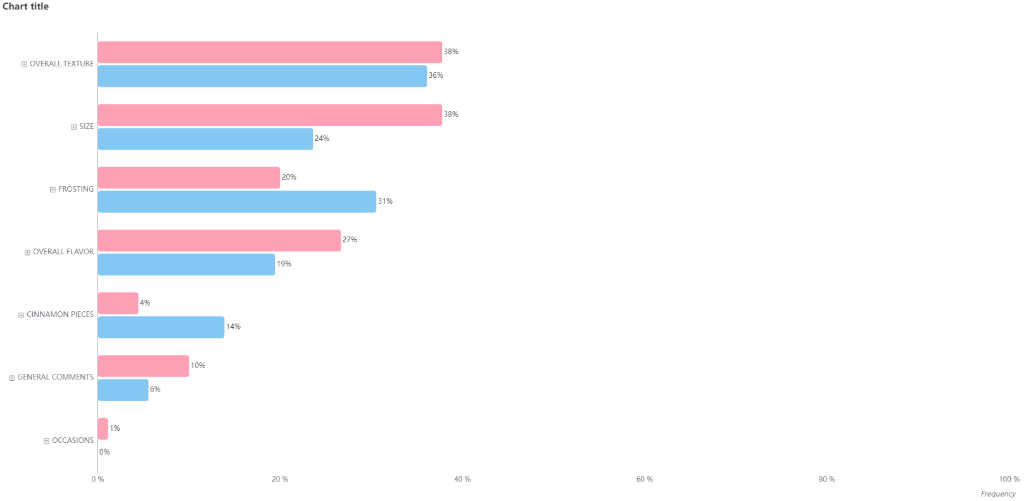
Change
OO 1-5
OO 6-9
590 (High Drizzle)
254 (Low Drizzle)
KEY
What do you like about the sample?” / “What, if anything, would you change about this sample to make it better?” N=c.131

